Slide 1
BIG DATA AND VISUALIZATION
TEAM-4

Slide 2

INDEX
● INTRODUCTION
● OBJECTIVE
● PROBLEM STATEMENT
● ARCHITECTURE
● WORKFLOW
● OUTPUT AND INSIGHTS
● CONCLUSION
● OUR TEAM

Slide 3
INTRODUCTION
Margie Travels, a concierge services provider is on a lookout for enhancing their customer’s experience with flight booking by leveraging machine learning capabilities to predict likelihood of flight delay for a given booking.
Plan a bulk data import operation, followed by preparation, such as cleaning and manipulating the data for testing, and training your Machine Learning model.
Loading the transformed data into PowerBI for data visualization so as to get deeper data insights.

Slide 4
OBJECTIVE
Build a complete Azure Machine Learning (ML) model.
Integrate an Azure ML web service into a Web App.
Use Azure Data Factory (ADF) for data movement and operationalizing ML scoring.
Summarize data with HDInsight and Spark SQL.
Visualize batch predictions on a map using Power BI.

Slide 5
PROBLEM STATEMENT
To enhance customer experience, we need to create a machine learning prediction model that takes historical data on flight delays and weather conditions as their input so as to identify whether a flight is likely to be delayed or not.

Slide 6
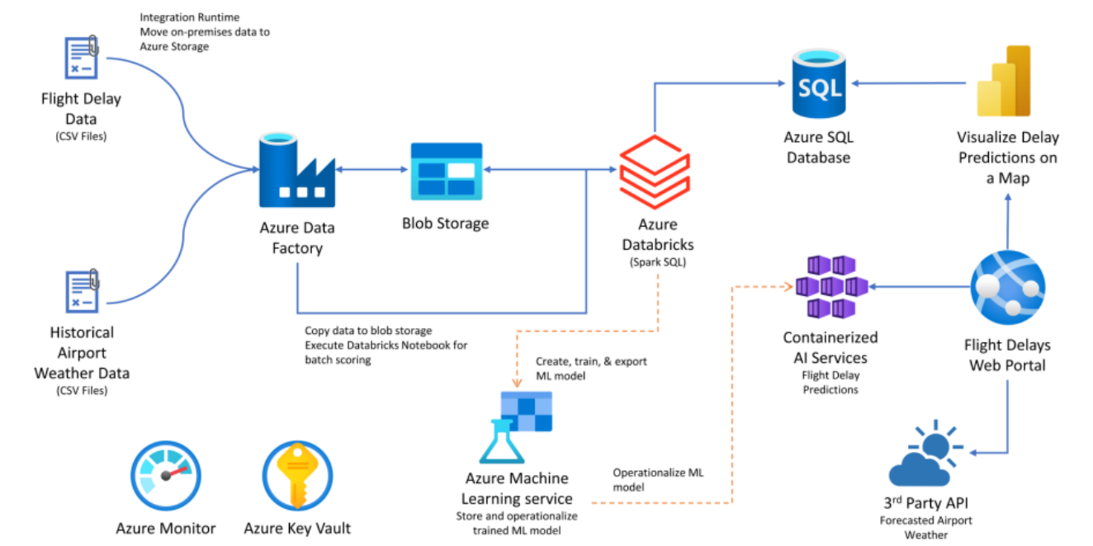
ARCHITECTURE

Slide 7
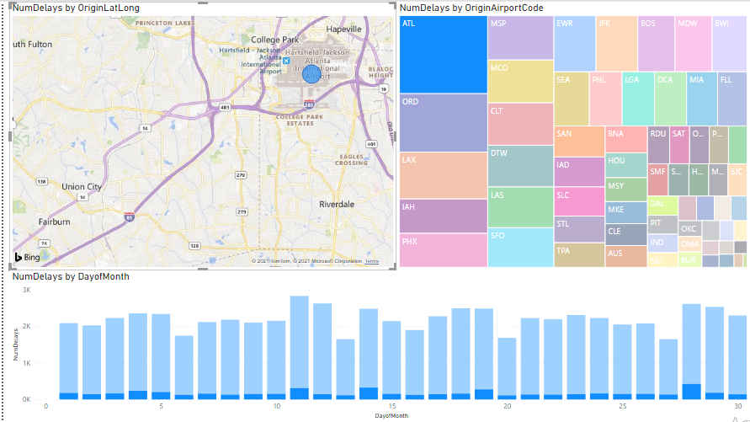
OUTPUT AND INSIGHTS

Slide 8
WORKFLOW
Data loading and Preparation
Machine learning modelling
Operationalizing Machine Learning
Developing a Data Factory pipeline for data movement
Visualization and Reporting- Flight Delay Data over Map

Slide 9
OUR TEAM
Rishabh Vedant
Rohit Rajshekar Chimkode
Ronali Sahu
Sai Chandana Gummadi
Shiva Prasad kartan

Slide 10


